Slide 1
C Programming Language
Project Presentation

Slide 3
C Programming Language
Project Presentation

Slide 6
C Programming Language
Project Presentation

Slide 11















for (i = 0; i n; ++i) students[i].total 0; printf("\nStudent %d ID: ", i+1);
#incIude «stdio.h»
#incIude <string.h>
#öcí n MAX ITU O ENTS OO
scanf( %u", &st uclents[i].iu);
#defi ne MAX SUBJECTS IO
pi inIf(' Name "),
Şpedef struct {
scanf(" 649["\n]", students[i].name);
for (j O; j m; ++j)
printf("Mark for subject 96d: j+1);
int id;
char name[50],
int marks[MŒ_SUBJECTS],
scanf("%d", &students[i].marks[j]);
students[i].total students[i].marksğ];)
foatave+uce;
clsnr¿iaue,
ca rade(students[i].average);) printf("\n\nID\tName\tTotaI\tAverage\tGrade\n");
Student;
char caIc_grade(float avg) { if (avg 9O) return 'A';
else if (avg >= 75) return 'B';
for (i O; i n; ++i) (
printf("Bd\t96s\t96d\t%.2f\t96c\n", students[i].id, students[i].name,
else if (avg »= 60) return 'C';
students[i].total,
else if (avg >= 50) return 'D';
students[i].average, students[i].grade);)
return 'F',)
int top 0;
int main() {
(or \i -- 1; i < n; ++i)
int n, m, i,j;
if (students[i].total » students[top].total) top = i;
Student students[MAX STUDENTS];
printf("\nTop Performer: %s (ID: %d) Total: %d
printf("Enter number of students: ");
Average: %.2f\n",
scanf("%d", &n);
students[top].name, students[top].id,
printf("Enter number of subjects: "); scanf("%d", &m);
students[topj.total, students[topj.average);
C Programming Language
Project Presentation
return O;)

Slide 12
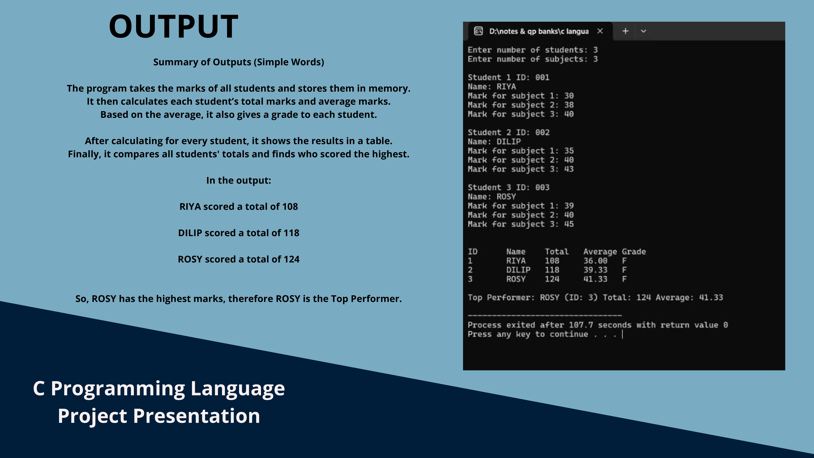

Slide 13
C Programming Language
Project Presentation

Slide 14
C Programming Language
Project Presentation

